Slide 1
Lecture 8: Regression 2
Jibo He, Ph.D.
Associate Professor
Wichita State University
jibo.he@Wichita.edu

Slide 2
Estimated Regression Line
Y
=“y hat”: predicted value of Y for X_{i}
X

Slide 3
Review about Linear Regression
X: predictor
Y: Criterion
Y=a+bX+ε
The sum of the deviations around the regression line will be less than the sum of the deviations around any other line, why?

Slide 4
Exercise
A researcher discovers the following information about the association between Variable X and Variable Y.
Mean of X=20, Standard deviation of X=6
Mean of Y=100, Standard deviation of Y=30
r=+0.83
(1) Calculate a and b in the regression equation.
(2) If X_{i}=2, what is the predicted value of Y_{i}?

Slide 5
Example 2
Find the regression line using the simpler computation formula you learned today
Student | X (Quiz 1) | Y (Quiz 2) | X*X | X*Y
1 | 9 | 10 | 81 | 90
2 | 7 | 9 | 49 | 63
3 | 3 | 2 | 9 | 6
4 | 8 | 6 | 64 | 48
5 | 2 | 4 | 4 | 8
6 | 5 | 6 | 25 | 30

Slide 6
Basic Assumptions (for Simple Linear Regressions)
X & Y are quantitative variables (Make sure the minimum level of underlying scale is interval)
Linear relationship between X & Y (draw scatter plot)
Independence of observations
For instance, you can not draw observations from twins
Make sure the sample is a random sample

Slide 7
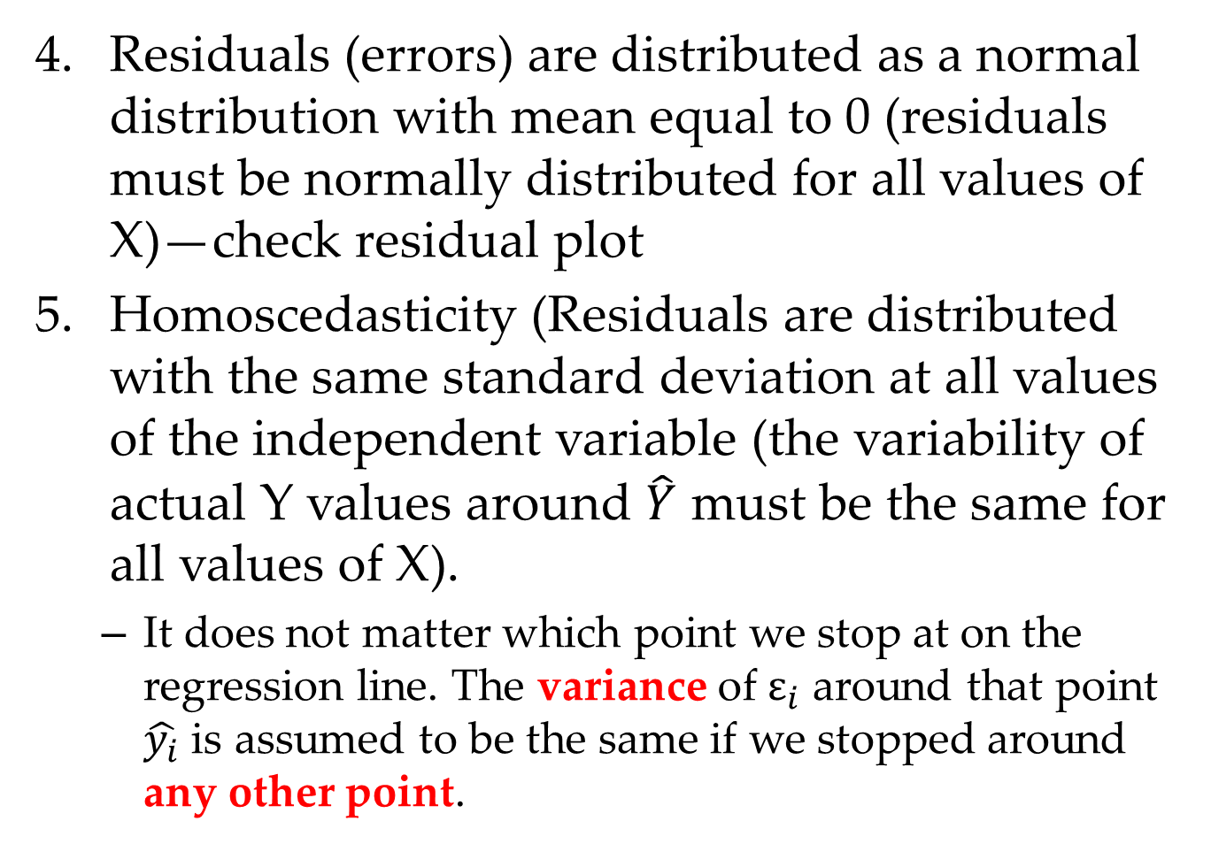
Residuals (errors) are distributed as a normal distribution with mean equal to 0 (residuals must be normally distributed for all values of X)—check residual plot
Homoscedasticity (Residuals are distributed with the same standard deviation at all values of the independent variable (the variability of actual Y values around $\hat{Y}$ must be the same for all values of X).
It does not matter which point we stop at on the regression line. The variance of $ε_{i}$ around that point $\hat{y_{i}}$ is assumed to be the same if we stopped around any other point.

Slide 8
Graphically display of Homoscedasticity
We can check such assumption via scatter plot
Homoscedasticity
Heteroscedasticity
Y
Y
X
X

Slide 9
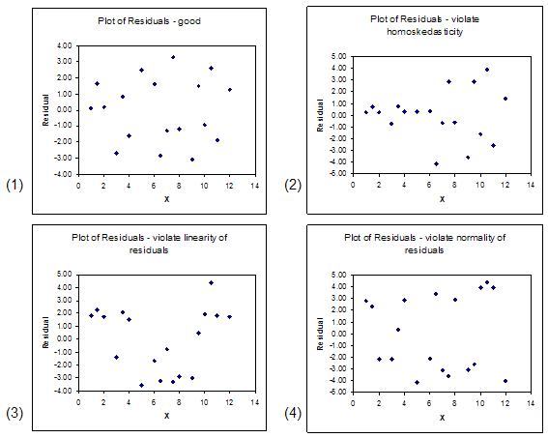
Graphs of residuals—Residual Plot

Slide 10
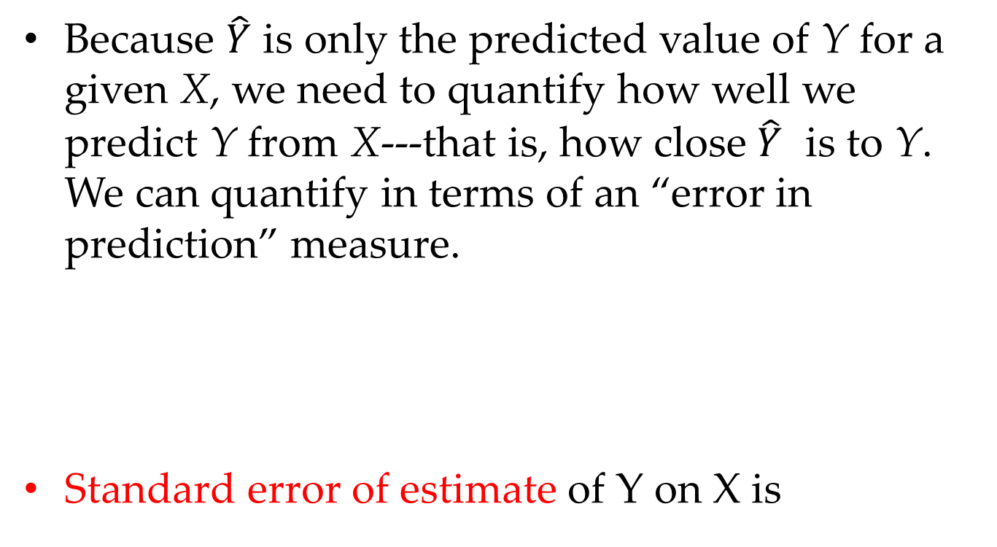

Evaluating the Quality of Prediction
Because $\hat{Y}$ is only the predicted value of Y for a given X, we need to quantify how well we predict Y from X---that is, how close $\hat{Y}$ is to Y. We can quantify in terms of an “error in prediction” measure.
Standard error of estimate of Y on X is
$$s_{Y·X}^{}$$

Slide 11
Regression Conceptualized
We could conceptualize each point as the following
We have three different variability
: Total variability
: Variability accounted for by the regression line (variability due to X)
: error (residual)
Is the regression line better than the mean? Is the error small?
Notes:
Regression is useful if the variability of the second part is large relative to the variability of the third part.

Slide 15
Regression and Correlation
The square of Pearson Correlation Coefficient = r²_{xy} (called coefficient of determination); this is interpreted as the proportion of variance in Y which can be explained or accounted for by the predictor X.
Since r²_{xy} is a proportion, values near 1.0 indicate good ability to predict Y
r²_{xy} is a relative index of the quality of prediction

Slide 16
Correlation and Regression
Another important conclusion!

Slide 17
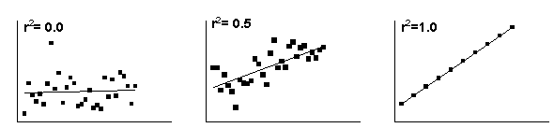
Coefficient of Determination
If two variables are strongly correlated – either positively correlated “or” negatively correlated, then their regression equation will be reliable. In other words, if r² is larger, the regression equation is more reliable .

Slide 18
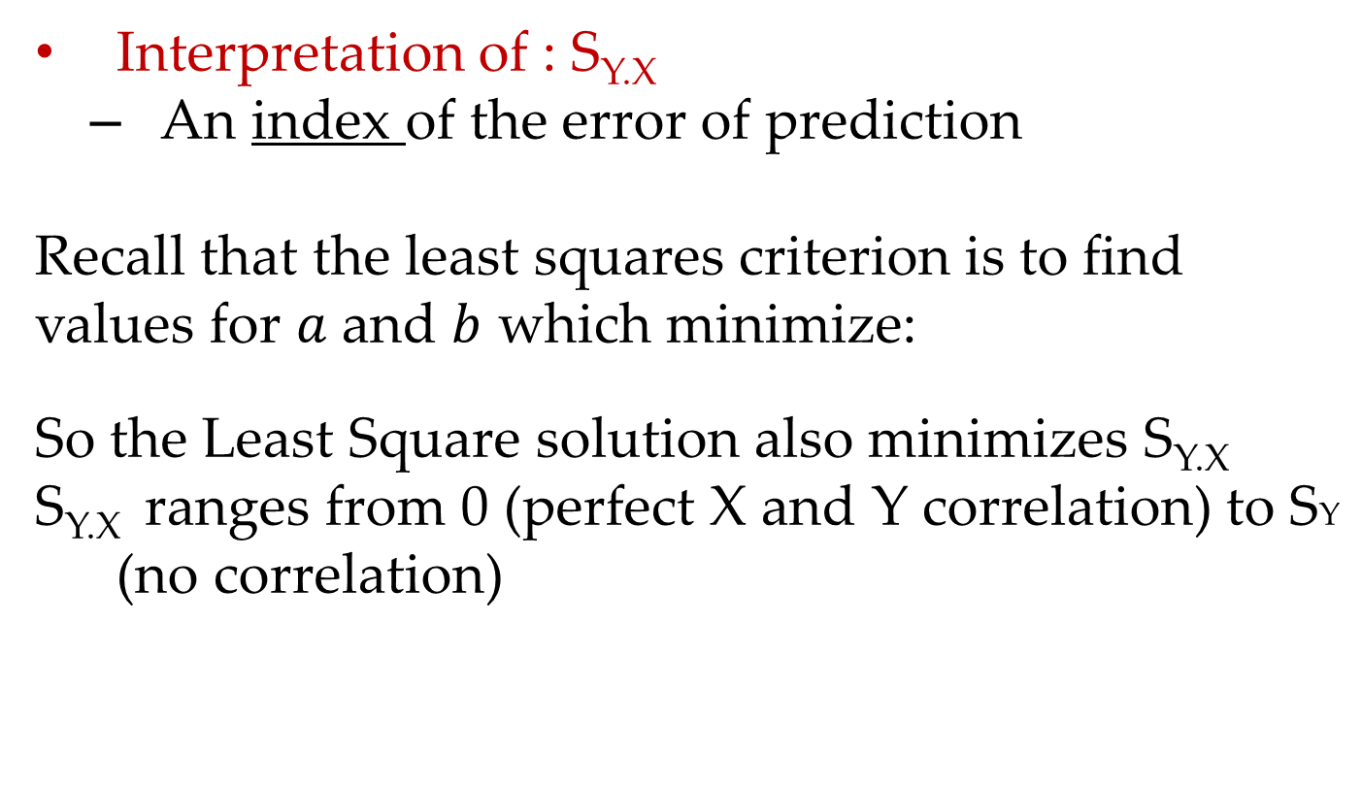
Standard Error of Estimate
Interpretation of : S_{Y.X}
An index of the error of prediction
Recall that the least squares criterion is to find
values for $a$and $b$ which minimize:
So the Least Square solution also minimizes S_{Y.X}
S_{Y.X} ranges from 0 (perfect X and Y correlation) to SY (no correlation)

Slide 19
Example
Assume you have collected information from customers at a local bookstore. More specifically, for 10 customers, you have the following information on their levels of education and cost on book purchases.
Mean of X=13, Standard deviation of X=3.46
Mean of Y=15.7, Standard deviation of Y=15.28
Sum of the cross products (Z_{X} *Z_{Y}) for the 10 cases is 7.49
Questions
Calculate and interpret r.
Calculate and interpret r²
Calculate a and b in the regression equation
Calculate the standard error of the estimate

Slide 20
Summary
The purpose of regression analysis is to predict the value on dependent variable (Y) given the value on independent variable (X).
How to find the best fitting straight line (regression line)?---least square method to find intercept and slope to minimize sum of squared error (SSE). ---Write down the equations.

Slide 21
Summary
Squared correlation coefficient is also called coefficient of determination, which quantifies the variability in Y that can be explained by variability in X.
Assumptions of regression analysis
Independence of pairs of observations
Linear relationship between X and Y
Homoscedasticity
Normal residual distribution

Slide 22
Correlation and regression
Higher correlation between X and Y, smaller standard error of estimate
See figures on the board
Notes:
Oct 01_ Mark’s notes

Slide 23
Exercise 2
Find the correlation coefficient using the simpler computation formula
Student | X (Quiz 1) | Y (Quiz 2) | X*X | X*Y
1 | 2 | 1
2 | 3 | 4
3 | 4 | 3
4 | 5 | 4
5 | 6 | 7

Slide 24
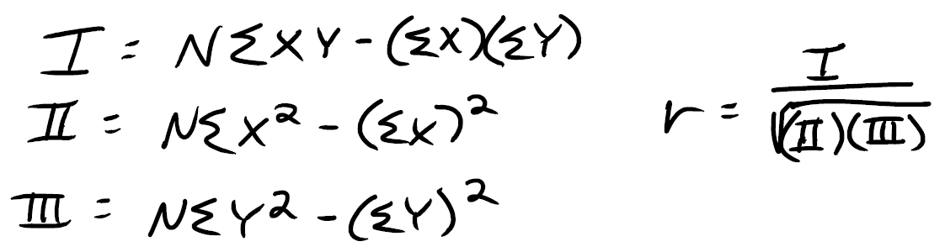
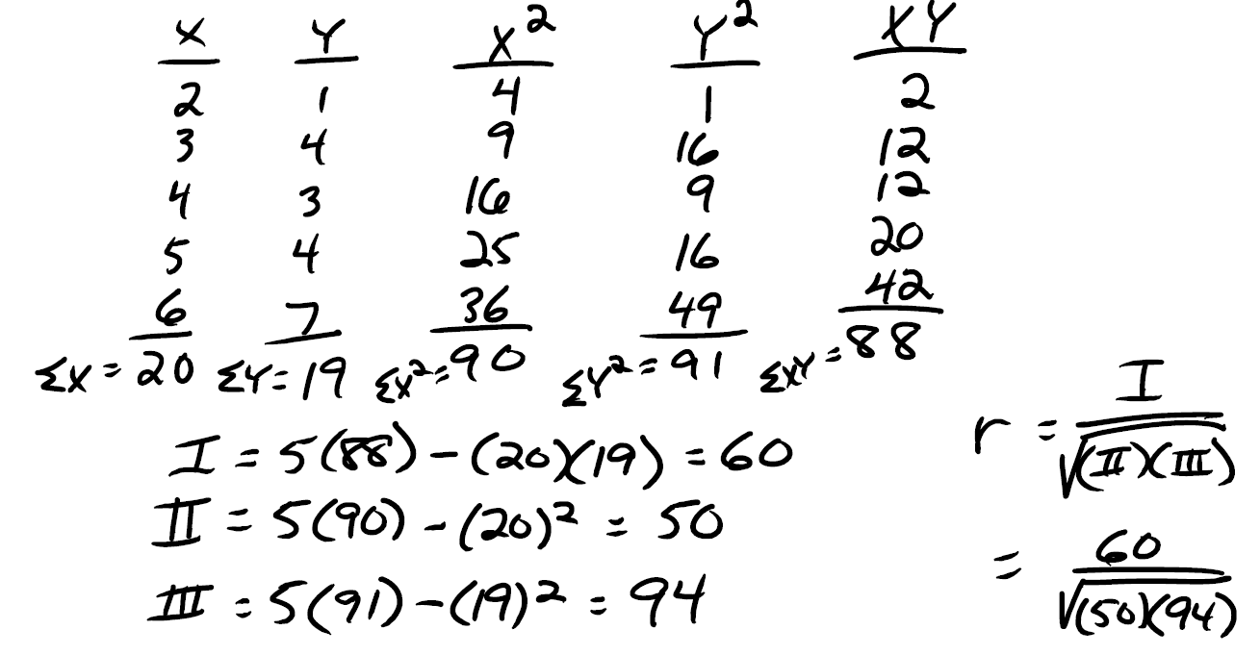
Computational formula and example

Slide 25
Example
(1) Find the regression line; (2) Find standard error of measurement
Student | X (Quiz 1) | Y (Quiz 2) | X*X | X*Y | Y_hat | error | error^2
1 | 2 | 3
2 | 3 | 4
3 | 5 | 6
4 | 1 | 4
5 | 7 | 3

